Slide 1




Next Generation AI for Power Electronics: Explainable, Light, and Flexible
Organizer: Dehong Xu, Homer Alan Mantooth
Speaker: Xinze Li, Fanfan Lin, Huai Wang, Xin Zhang

Slide 2
Section I. Applications of AI in Power Electronics
Speaker: Xin Zhang, Huai Wang

Slide 3
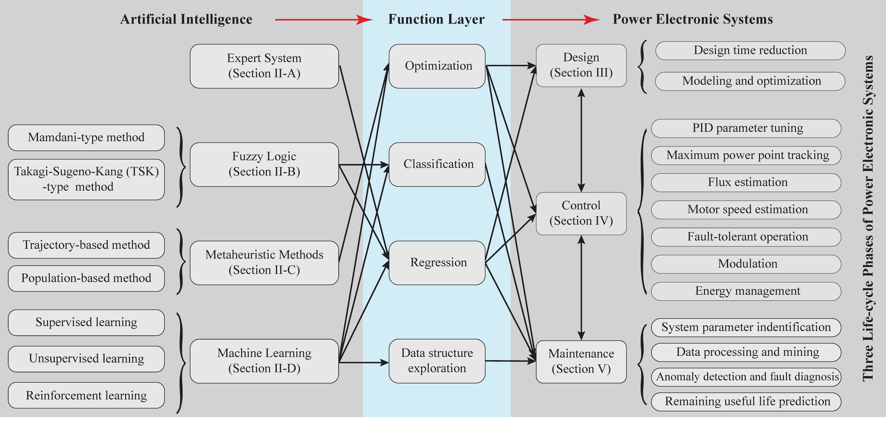
Applications of AI in Power Electronics
I
Xin Zhang, Huai Wang
Applications of AI in Power Electronics
Source: Shuai Zhao, Frede Blaabjerg, and Huai Wang, “An overview of artificial intelligence applications for power electronics,” IEEE Transactions on Power Electronics, vol. 36, no. 4, pp. 4633 – 4658, Apr. 2021.

Slide 4
Applications of AI in Power Electronics
I
Xin Zhang, Huai Wang
Percentage of AI Tasks in Power Electronics
Percentage in the existing research work
9.8% for Design
77.8% for Control
12.4% for Maintenance and Fault Diagnosis
Source: Shuai Zhao, Frede Blaabjerg, and Huai Wang, “An overview of artificial intelligence applications for power electronics,” IEEE Transactions on Power Electronics, vol. 36, no. 4, pp. 4633 – 4658, Apr. 2021.

Slide 5
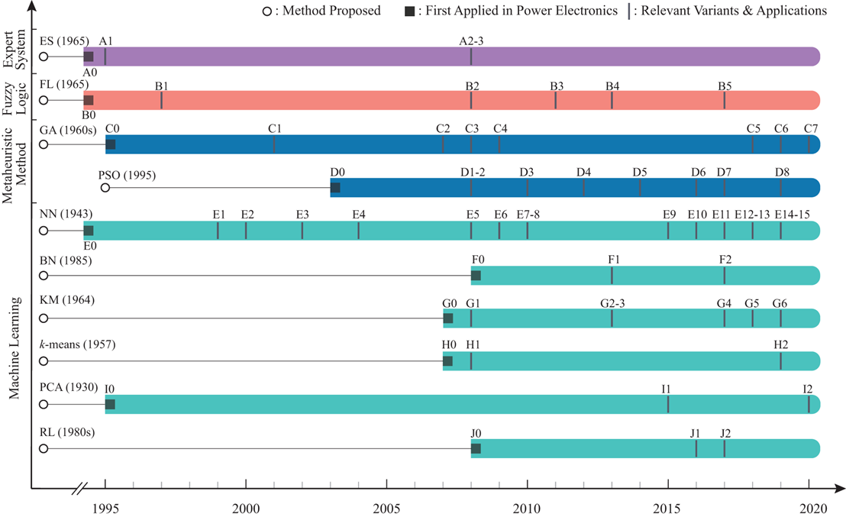
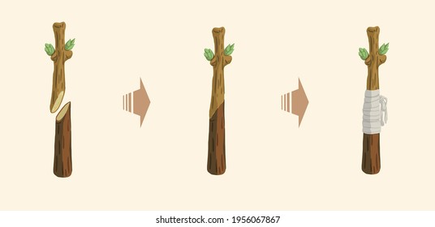
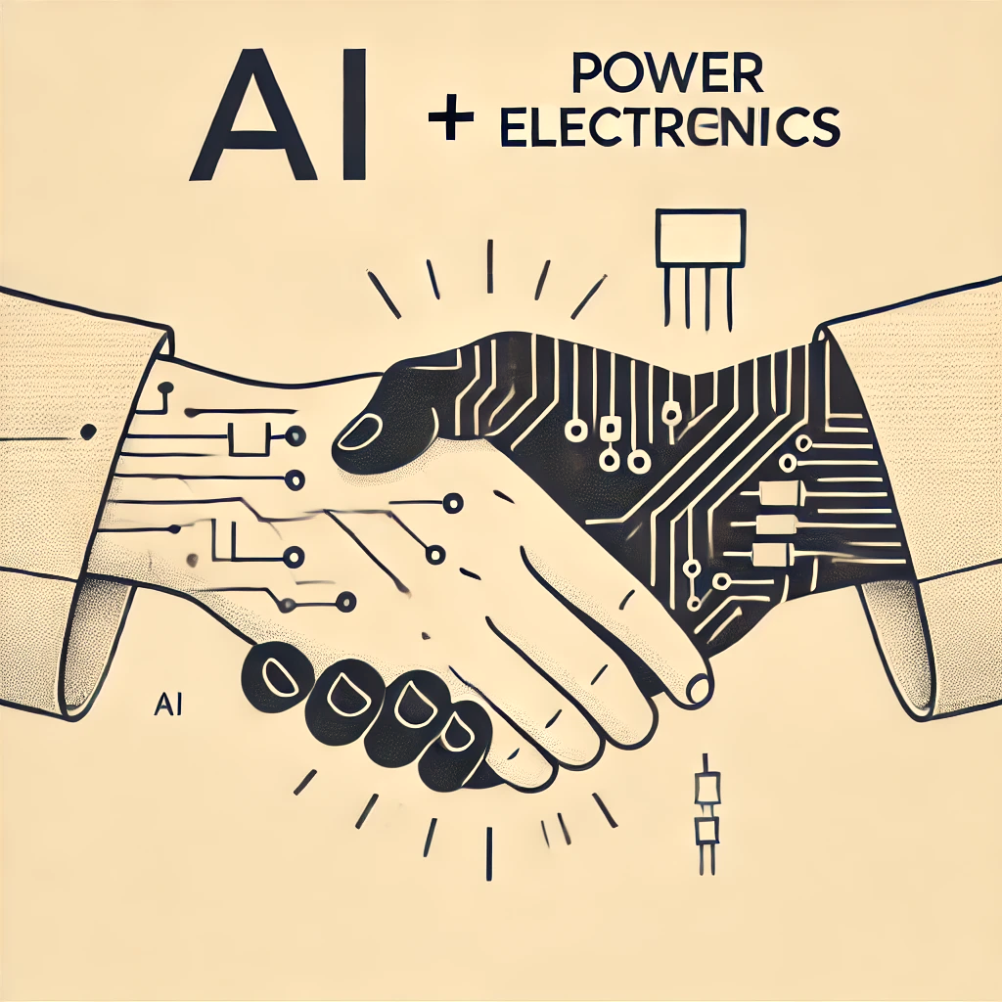
Applications of AI in Power Electronics
I
Xin Zhang, Huai Wang
Timeline of AI Algorithms Applied in Power Electronics
Just like plant grafting, where a specific branch is carefully chosen and integrated into a compatible rootstock
AI needs to be adapted and enhanced with power electronics expertise.

Slide 6
Applications of AI in Power Electronics Design
I
Xin Zhang, Huai Wang
Existing Application 1: AI-Based Circuit and Control Design
Abstract diagram of circuit and control design through AI-based methods

Slide 7

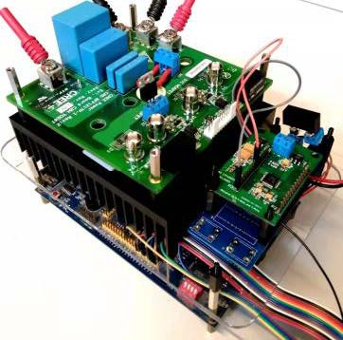


Applications of AI in Power Electronics Design
I
Xin Zhang, Huai Wang
AI-in-Loop System for Modulation Design of DAB Converters
①
Support vector machine
Residual models to deal with model deviation
y = f_{ML} (x)
Data collection
Outlier exclusion
②
AI-based data-driven modeling
Hardware experiments
Data-driven digital model
AI-empowered Model-Based Design to streamline modeling, optimization, and design iteration
④
Meta-heuristic optimization
Fuzzy logic for online deployment
Meta-heuristic algorithm
③
Source: X. Li, X. Zhang, F. Lin, C. Sun and K. Mao, "Artificial-Intelligence-Based Triple Phase Shift Modulation for Dual Active Bridge Converter With Minimized Current Stress," in IEEE Journal of Emerging and Selected Topics in Power Electronics, vol. 11, no. 4, pp. 4430-4441, Aug. 2023.
X. Li et al., "Data-Driven Modeling With Experimental Augmentation for the Modulation Strategy of the Dual-Active-Bridge Converter," in IEEE Transactions on Industrial Electronics, vol. 71, no. 3, pp. 2626-2637, March 2024

Slide 8
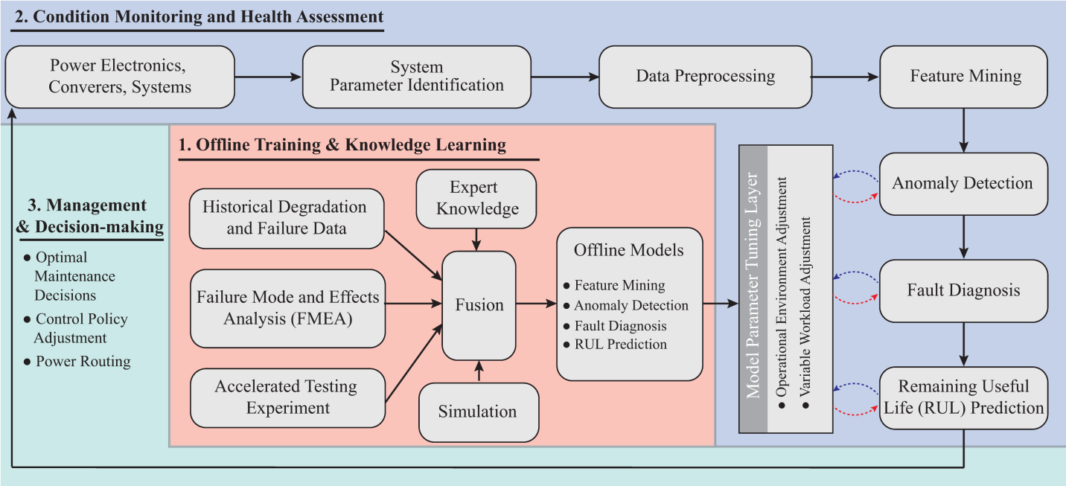
Applications of AI in Converter Condition Monitoring
I
Huai Wang, Xin Zhang
Existing Application 2: Digital Twin Based Condition Monitoring
Source: S. Zhao, Y. Peng, Y. Zhang and H. Wang, "Parameter Estimation of Power Electronic Converters With Physics-Informed Machine Learning," in IEEE Transactions on Power Electronics, vol. 37, no. 10, pp. 11567-11578, Oct. 2022.

Slide 9
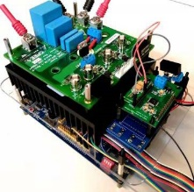
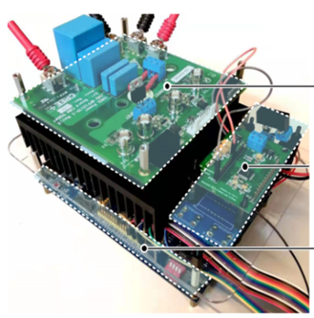
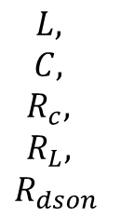
Applications of AI in Converter Condition Monitoring
I
Huai Wang, Xin Zhang
Existing Application 2: Digital Twin Based Condition Monitoring
Circuit parameters
$$\begin{matrix}L, \\ C, \\ R_{c}, \\ R_{L}, \\ R_{dson}\end{matrix}$$
Digital twin models share the same operational characteristics and internal device parameters as their physical counterparts.
High-precision digital twin models can be used for real-time system optimization, health assessment, device performance prediction, and more.
Source: S. Zhao, Y. Peng, Y. Zhang and H. Wang, "Parameter Estimation of Power Electronic Converters With Physics-Informed Machine Learning," in IEEE Transactions on Power Electronics, vol. 37, no. 10, pp. 11567-11578, Oct. 2022.

Slide 10
Applications of AI in Converter Condition Monitoring
I
Huai Wang, Xin Zhang
Existing Application 2: Digital Twin Based Condition Monitoring
System Digital Twin Model: Circuit Model, Control, Sampling
Schematic diagram of AI-based digital twin

Slide 11
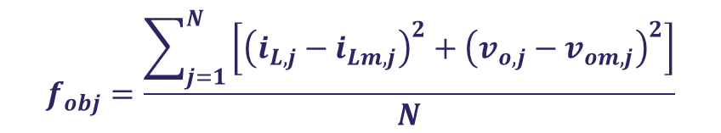
Applications of AI in Converter Condition Monitoring
I
Huai Wang, Xin Zhang
Existing Application 2: Digital Twin Based Condition Monitoring
Meta-Heuristic Optimizer, e.g.
Particle Swarm Optimization (PSO）
$$f_{obj}=\frac{\sum_{j=1}^{N}{\left[{\left(i_{L,j}−i_{Lm,j}\right)}^{2}+{\left(v_{o,j}−v_{om,j}\right)}^{2}\right]}}{N}$$
No additional hardware required.
No calibration needed.
Converter-level condition monitoring solution, capable of monitoring multiple devices simultaneously.
Parameter identification algorithm

Slide 12
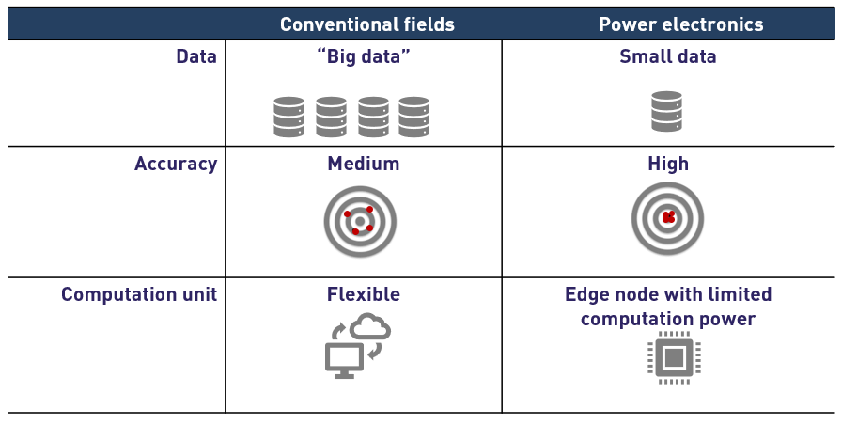
Challenges of Existing AI in Power Electronics
I
Huai Wang, Xin Zhang
Challenge 1: Power Electronics Requires Data-Light and Computation-Light AI
Characteristics of power electronics and other fields
Source: Aalborg University, “Researchers will design cognitive power electronics”,
https://www.aau.dk/researchers-will-design-cognitive-power-electronics-n28286

Slide 13
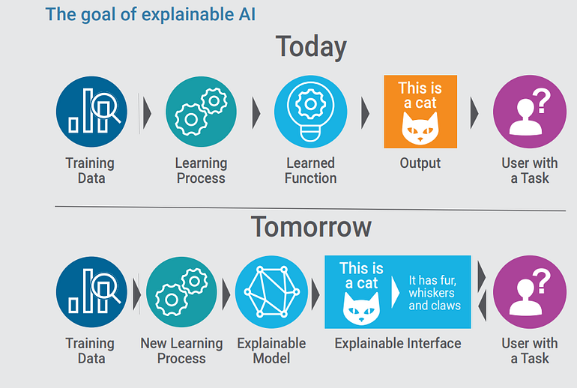
Challenges of Existing AI in Power Electronics
I
Huai Wang, Xin Zhang
Challenge 2: Explainability of AI to Enhance Deployment Confidence
Leverage PE-GPT to Provide Power Electronics Insights into a Designed Buck Converter
User:
For the task to design LC filter for the buck converter which has minimum current ripple, why do you recommend this inductor value?
PE-GPT by F. Lin et al.
AI:
The inductor helps to smooth out the ripple in the output current by resisting sudden changes in current flow. Lower ripple percentages typically require larger inductors.
Source: https://towardsdatascience.com/need-for-explainability-in-ai-and-robotics-75dc6077c9fa;
F. Lin et al., "PE-GPT: A New Paradigm for Power Electronics Design," in IEEE Transactions on Industrial Electronics, doi: 10.1109/TIE.2024.3454408.

Slide 14
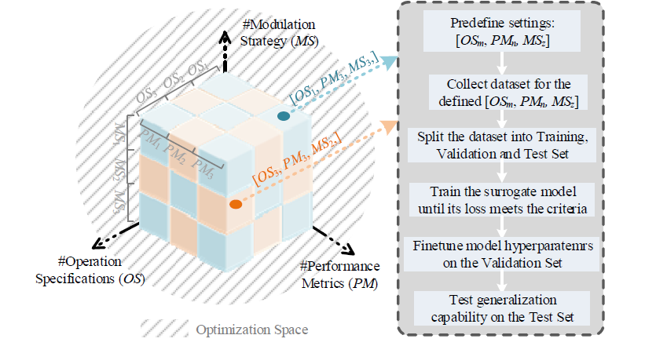
Challenges of Existing AI in Power Electronics
I
Huai Wang, Xin Zhang
Challenge 3: Flexibility for Diverse Converters and Operating Conditions
Traditional data-driven is fixed in operational settings, limiting model flexibility when settings change.
Building separate surrogate models for all settings is data-intensive and computationally demanding.
Handling multiple settings need N_{t}​=m×n×z models (imaging only 3 variables), increasing complexity significantly.
Topology, circuit parameters, control strategies, performance metrics, operation specifications, etc., could all change.
Number of models required for variable modulation strategy, operation specification, and performance metrics

Slide 15
Section II. Physics-Informed Machine Learning (PIML) for Power Electronics
Speaker: Xinze Li

Slide 16

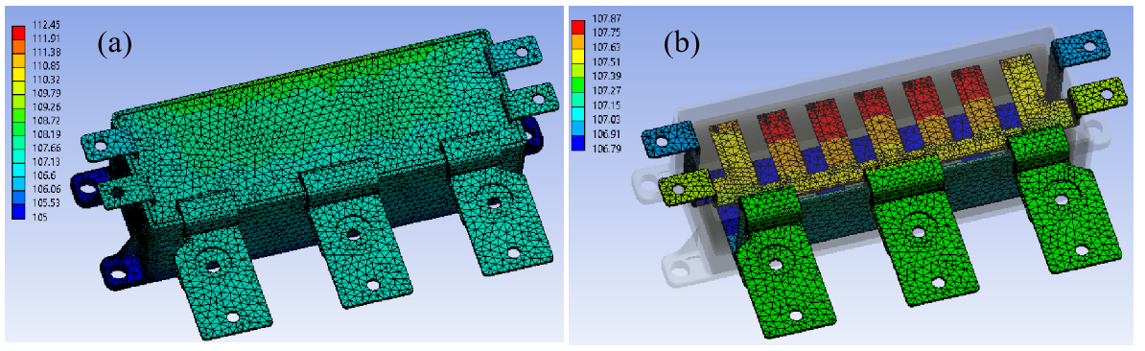


Concept of Physics-Informed Machine Learning
II
Xinze Li, Fanfan Lin, Homer Alan Mantooth
Concept of Physics-Informed Machine Learning (PIML):
Physics Laws Expressed as Partial Differential Equations (PDEs)
Ill-posed scenarios
Noisy or missing data
Deficient physical models
Mesh-free
Integrate physics
Forward Problem (Solve PDEs)
Steer the learning of PIML towards identifying physically consistent solutions
Identify parameters
Easy mathematical formulation
Rich support in AI fields
Machine Learning Models
Source: G. E. Karniadakis, I. G. Kevrekidis, L. Lu, P. Perdikaris, S. Wang, and L. Yang, “Physics-informed machine learning,” Nat Rev Phys, vol. 3, no. 6, pp. 422–440, May 2021, doi: 10.1038/s42254-021-00314-5
Inverse Problem (Infer Parameters)

Slide 17
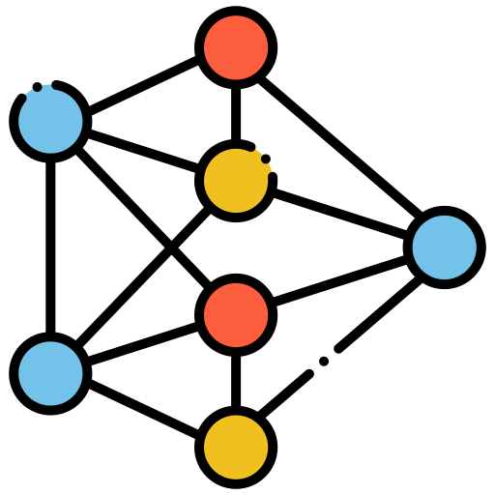



How to Embed Physics into Machine Learning
II
Xinze Li, Fanfan Lin, Homer Alan Mantooth
Main Types of PIML Approaches:
Reveal data invariant
Introducing inductive biases
Introducing learning biases
Adjust prior distribution
Physics is embedded into loss terms for training
Physics is embedded directly into neural structure
Initialize neural weights for physically informed starting points
Physics-in-Loss PIML
Physics-in-Architecture PIML
Physics-in-Initialization PIML
Most widely applied
Focus of this Session

Slide 18
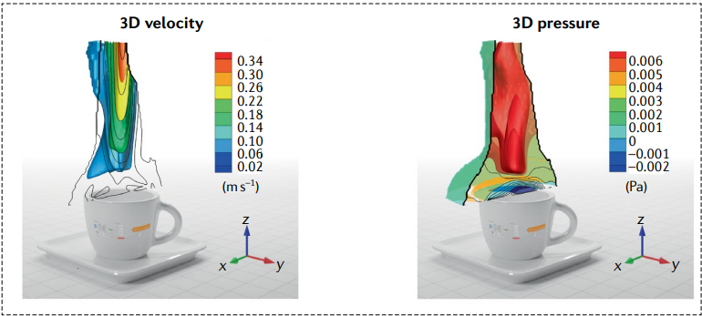
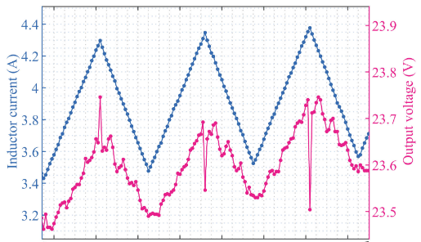
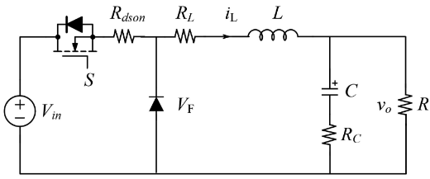
Physics-in-Loss PIML
II
Xinze Li, Fanfan Lin, Homer Alan Mantooth
Physics-in-Loss PIML and Some Applications:
Solve PDEs with partially hidden physics
Physics as PDEs:
AutoDiff
Parameter identification for power converters
Identify
Loss Terms
Data acquisition
Circuit parameters
Source: G. E. Karniadakis, I. G. Kevrekidis, L. Lu, P. Perdikaris, S. Wang, and L. Yang, “Physics-informed machine learning,” Nat Rev Phys, vol. 3, no. 6, pp. 422–440, May 2021.
S. Zhao, Y. Peng, Y. Zhang, and H. Wang, “Parameter Estimation of Power Electronic Converters With Physics-Informed Machine Learning,” IEEE Transactions on Power Electronics, vol. 37, no. 10, pp. 11567–11578, Oct. 2022.

Slide 19

Physics-in-Architecture and Physics-in-Initialization
II
Xinze Li, Fanfan Lin, Homer Alan Mantooth
Physics-in-Architecture and Physics-in-Initialization PIMLs
Physics as PDEs
Conventional ML Models
Discretization with numerical differentiation
Randomly initialized with small weights (Xavier Initialization)
Steer the Physics-Crafted Structural Design of ML
Physics as PDEs
Initialize neural parameters to meet certain physical constraints
θ
Neural parameters θ are endowed with direct physical meanings
Physics-in-architecture
Physics-in-initialization

Slide 20
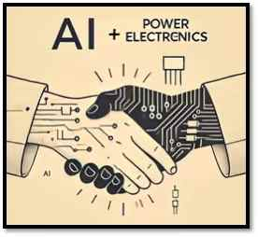
Pros and Cons of Main PIML Methods
II
Xinze Li, Fanfan Lin, Homer Alan Mantooth
Pros and Cons of Main PIML Methods:
Physics-in-Architecture
Physics-in-Loss
Physics-in-Init.
Purely Data-Driven
Few Data
Some Data
Massive Data
~ 10⁰ to 10¹
~ 10² to 10³
≥ 10⁴
Less Data
More Lightweight
More Flexible
More Explainable
Data Requirements
Stronger Data-Driven Capacity
Physics Effectiveness
Well-Posed
Allow for Hidden Physics
NO
Many Physics
Some Physics
NO Physics
Low data-driven capacity
Limited to simpler physical formulation
Physics inconsistent
Necessitate re-train for out-of-domain scenarios
More training epochs
No physical meaning
Massive data needed
Black-box and heavy model
Disadvantages

Slide 21
Section III. Fundamentals of PANN and its Explainability in Power Electronics
Speaker: Xinze Li

Slide 22

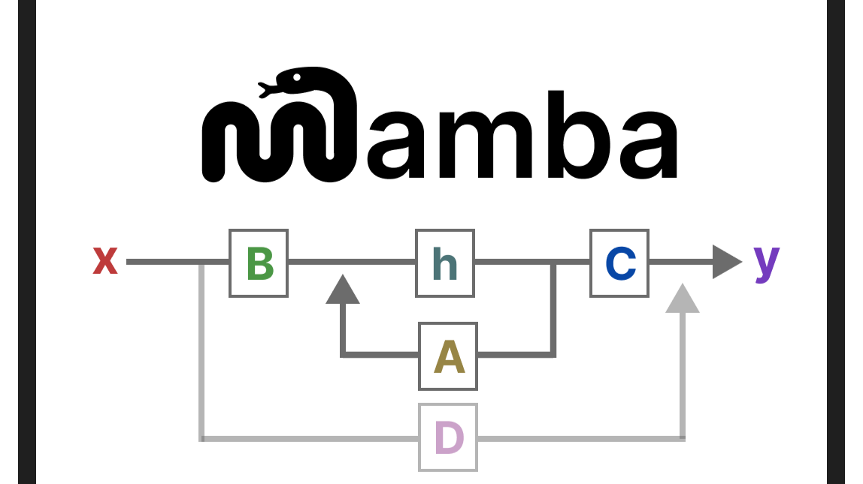
Introducing PANN: Next-Generation of AI for PE
III
Xinze Li, Fanfan Lin, Homer Alan Mantooth
Concept of PANN: Physics-in-Architecture Neural Network (PANN)
All roads lead to destination, but PANN is a Shortcut for PE
Embed PE physics in PDEs, neural θ denotes circuit parameters
Neural weights A ~ D have NO physical meanings
Physics-in-Architecture Neural Network (PANN)
(Submitted on 21 Jun 2023)
Mamba State Space Models (Submitted on 1 Dec 2023)
Source: [1] X. Li et al., "Temporal Modeling for Power Converters With Physics-in-Architecture Recurrent Neural Network," in IEEE Transactions on Industrial Electronics, vol. 71, no. 11, pp. 14111-14123, Nov. 2024.
[2] X. Li, F. Lin, X. Zhang, H. Ma and F. Blaabjerg, "Data-Light Physics-Informed Modeling for the Modulation Optimization of a Dual-Active-Bridge Converter," in IEEE Transactions on Power Electronics, vol. 39, no. 7, pp. 8770-8785, July 2024.
[3] F. Lin, X. Li, X. Zhang and H. Ma, "STAR: One-Stop Optimization for Dual-Active-Bridge Converter With Robustness to Operational Diversity," in IEEE Journal of Emerging and Selected Topics in Power Electronics, vol. 12, no. 3, pp. 2758-2773, June 2024.
[4] X. Li et al., "A Generic Modeling Approach for Dual-Active-Bridge Converter Family via Topology Transferrable Networks," in IEEE Transactions on Industrial Electronics, doi: 10.1109/TIE.2024.3406858.
[5] F. Lin et al., "PE-GPT: A New Paradigm for Power Electronics Design," in IEEE Transactions on Industrial Electronics, doi: 10.1109/TIE.2024.3454408.

Slide 23



Why PANN? Explainable! Light! Flexible!
III
Xinze Li, Fanfan Lin, Homer Alan Mantooth
Advantages of PANN: Explainable, Light, and Flexible
Explainable
Physics-crafted architecture through discretized state-space circuit equations
Power electronics explainable
Switching behaviors
Commutation loops
Light
Data-light
Reduce data by 3 orders of magnitudes
Countable in one hand
Lightweight
Deployable on edge
Down to kB level
Flexible
Training-free to out-of-domain scenarios
Operating conditions
Modulation strategies
Performance metrics
Circuit parameters
Topological variants
PANN is Suitable for Power Electronics Applications

Slide 24
Network Architecture and Principles of PANN
III
Xinze Li, Fanfan Lin, Homer Alan Mantooth
PANN is a form of Neural Partial Differential Equations (NeuralPDE)
Continuous
Generic state-space equations of power converters
Discrete
Expert Systems
Recurrent neural architecture of PANN
Trainable neural parameters, data-driven
Physically explainable, direct assignment

Slide 25
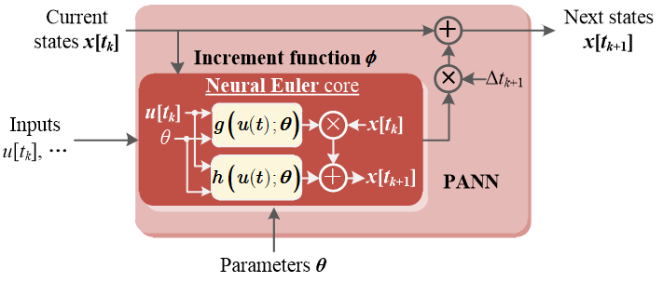
PANN Inference: Predict the Next State
III
Xinze Li, Fanfan Lin, Homer Alan Mantooth
PANN inference unfolded over time: predict the next state
Used as next
Implicit Cell
x[t_{k}]
x[t_{k+1}]
Physics-in-Architecture
unfolded
In modeling, teacher forcing is infeasible
Predicted state x[t_{k+1}] at t_{k+1} is used to infer the following state x[t_{k+2}] at t_{k+2}

Slide 26
PANN Inference: Predict the Next State
III
Xinze Li, Fanfan Lin, Homer Alan Mantooth
PANN inference unfolded over time: predict the next state
Time t_{k}
Time t_{k+1}
Time t_{k+2}

Slide 27
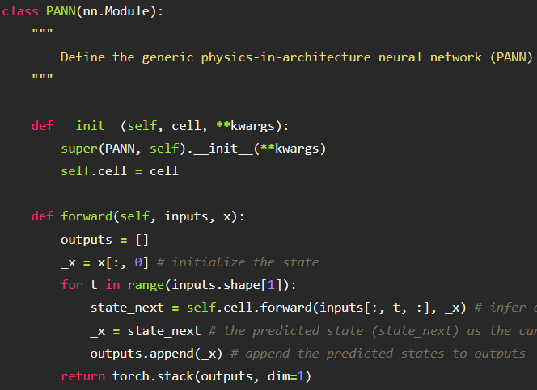


Code Structure for PANN Inference
III
Xinze Li, Fanfan Lin, Homer Alan Mantooth
Code Structure for PANN Inference
Module 1. Recurrence Cell
pann_net.py :: class PANN
Recurrent infer
Module 2. Input Blocks
Generate switching or input signals based on modulation knowledge
Module 3. Physics Cell
Infer state variables for one timestamp based on physics
PANN Inference
Physics Cell
x[t_{k}]
..., u[t_{k}], u[t_{k+1}], ...,
x[t_{k+1}]
Recurrent Inference
Module 1. Recurrence Cell
Infer state variable waveforms in a recurrent way

Slide 28
Case Study: PANN for DAB Converters
III
Xinze Li, Fanfan Lin, Homer Alan Mantooth
Case Study 1: PANN for DAB Converters
Continuous
Discretize via Implicit Euler Algorithm
Simplify
Equivalent Circuit of Inductor
 | Specs
States x(t) | i_{L}
Inputs u(t) | v_{p}, v_{s}
Circuit θ | R_{L}, L_{k}, n
PANN Structure for DAB

Slide 29
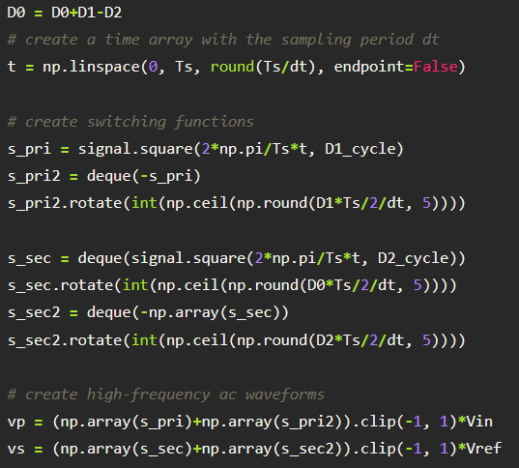
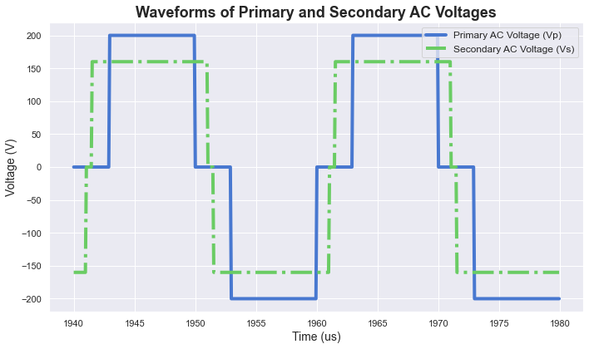
Case Study: PANN for DAB Converters
III
Xinze Li, Fanfan Lin, Homer Alan Mantooth
Case Study 1: PANN for DAB Converters
embed
Gate drive signal for s₁
Gate drive signal for s₄
Gate drive signal for s₅
args: (D₀, D₁, D₂, D_{1_cycle}, D_{2_cycle}, v_{i}, v_{o})
args: (0.1, 0.7, 0.95, 50%, 50%, 200, 160)
Gate drive signal for s₈
return:
Generate v_{p} and v_{s}
Module 2. Input Blocks
pann_utils.py :: def create_vpvs
To generate v_{p} and v_{s}
Exemplary v_{p} and v_{s} waveforms

Slide 30
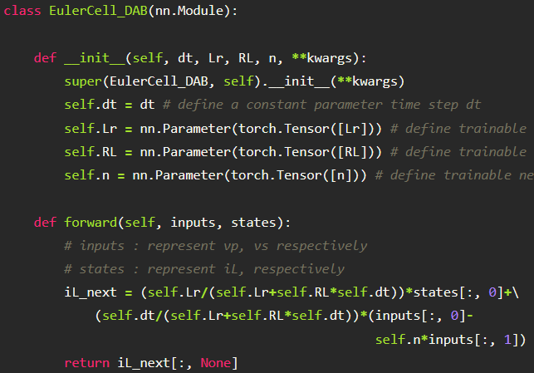
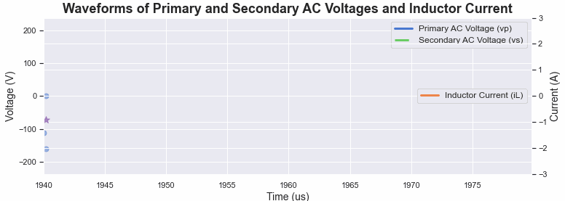
Case Study: PANN for DAB Converters
III
Xinze Li, Fanfan Lin, Homer Alan Mantooth
Case Study 1: PANN for DAB Converters
Animated inference breakdown
.
.
v_{p}
.
.
i_{L}
v_{s}
.
.
Expert system
t_{k}
t_{k+1}
t_{k+2}
Define neural circuit parameters θ
Physics of inductor
Embed physics
Module 3. Physics Cell
pann_net.py :: class EulerCell_DAB
Inference Breakdown (Code Demo*)
"DAB-inference and training.ipynb"

Slide 31
Next-Generation of Explainable AI for Power Electronics
III
Xinze Li, Fanfan Lin, Homer Alan Mantooth
Circuit Insights Revealed in PANN
Expert system
Switching behaviors
Commutation loop analysis
PANN pushes the definition of AI explainability to a NEW Height: Power Electronics Explainable

Slide 32
Exemplary Waveforms of PANN Inference for DAB
III
Xinze Li, Fanfan Lin, Homer Alan Mantooth
Exemplary waveforms of PANN for DAB
A DAB Variant (NPC-DAB) under TPS Modulation

Slide 33
Case Study: PANN for Buck Converters
III
Xinze Li, Fanfan Lin, Homer Alan Mantooth
Case Study 2: PANN for Buck Converters
Discretize via Explict Euler Algorithm
s[t_{k}]v_{i}
Simplify
Equivalent Circuit
 | Specs
States x(t) | i_{L}, v_{o}
Inputs u(t) | v_{a}
Circuit θ | R, L, C
Continuous
PANN Structure for Buck

Slide 34
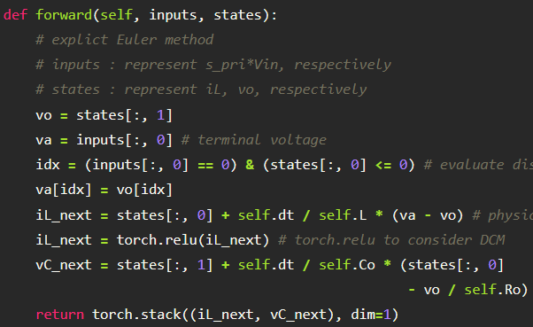
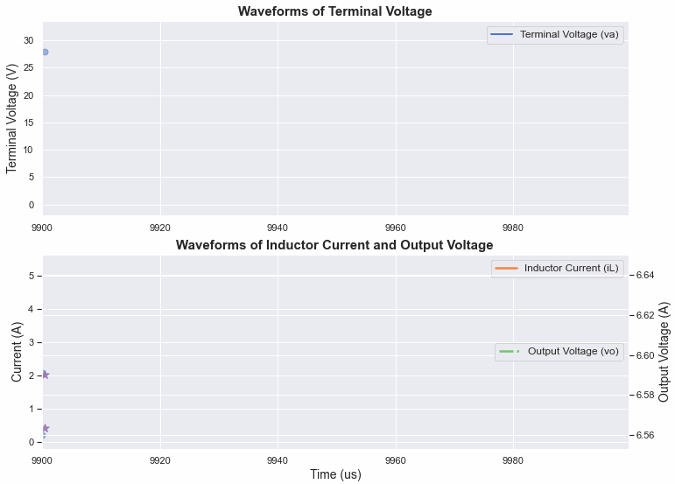
Case Study: PANN for Buck Converters
III
Xinze Li, Fanfan Lin, Homer Alan Mantooth
Case Study 2: PANN for Buck Converters
Determine DCM
Physics of inductor
Physics of capacitor
Embed physics
Module 3. Physics Cell
pann_net.py :: class EulerCell_Buck
Inference Breakdown (Code Demo*)
“Buck-inference.ipynb"

Slide 35
Next-Generation of Explainable AI for Power Electronics
III
Xinze Li, Fanfan Lin, Homer Alan Mantooth
Circuit Insights Revealed in PANN
Expert system
Switching behaviors
Commutation loop analysis
PANN pushes the definition of AI explainability to a NEW Height: Power Electronics Explainable

Slide 36









Key Takeaways of PANN Inference
III
Xinze Li, Fanfan Lin, Homer Alan Mantooth
Define states, inputs, outputs variables
1. To Customize PANN for ANY Power Converter
2.
Code Structure of PANN
Generate Input Signals
Embed Physics
II. Input Blocks
III. Physics Cell
Equivalent circuit
Continuous state-space circuit equations
Numerical
Takeaways
Discretized state-space
I. Recurrence Cell
Construct PANN
Loop through timestamps
Neural ODE/PDE
Time-domain modeling
Present predictions are used to predict next states
Infer state variables x(t) based on input variables u(t) from expert systems
Physics-crafted structure: state-space circuit physics
Physical compliance
Explainability in power electronics: switching behaviors, commutation loops, operating modes
PANN Inference
3. Main Features of PANN Inference
4.
Explain-ability of PANN

Slide 37
Section IV. PANN is Light in Two Aspects: Data-Light and Lightweight
Speaker: Xinze Li

Slide 38
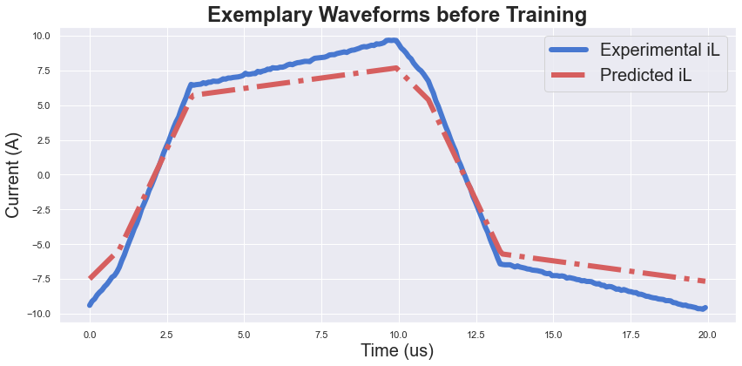

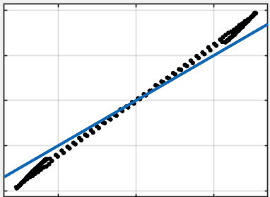


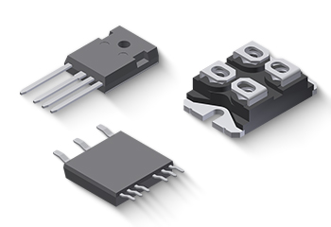

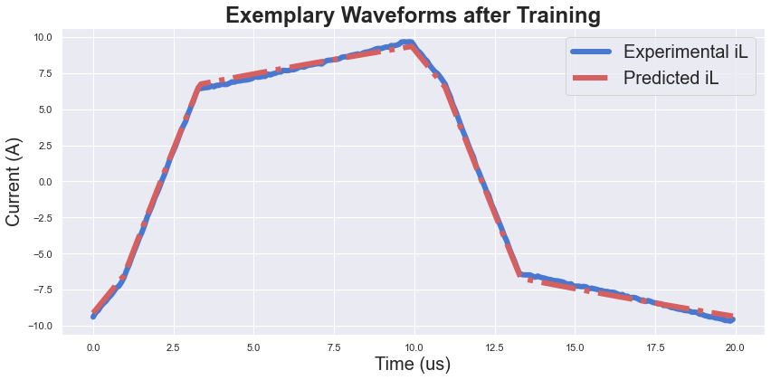

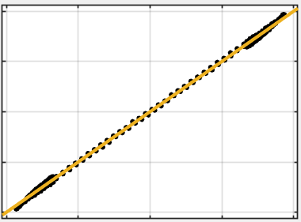
PANN Training: Adjust Neural Parameters to Minimize Loss
IV
Xinze Li, Fanfan Lin, Homer Alan Mantooth
Before Training
Training is Imperative to minimize losses
Neural θ before Training: R_{L} = 10 mΩ, L_{k} = 80 μH, n = 1.1
Manufacturing tolerance
Ambient variations
Thermal drift
Operation conditions
Electromagnetic interference
Aging and degradation
R² = 96.9%
Neural θ after Training: R_{L} = 1.8 Ω, L_{k} = 64 μH, n = 1.0
With Training
Deviated theoretical modeling
R² = 99.9%
After Proper Training

Slide 39
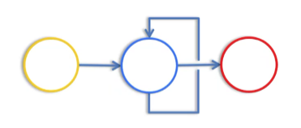
PANN Training: Flowchart and Breakdown
IV
Xinze Li, Fanfan Lin, Homer Alan Mantooth
PANN training breakdown
u[t_{k}], x[t_{k}]
x[t_{k+1}]
θ
infer
PANN with current neural parameters θ
expressed as tensors
update θ
Training Flowchart of PANN
Training Breakdown

Slide 40
Training Loop of PANN
IV
Xinze Li, Fanfan Lin, Homer Alan Mantooth
Evaluate Test Loss
Similar to PANN Inference, but without recording gradients
New epoch
Data Loader
torch.utils.data.DataLoader
Save checkpoint
Loaded training data
Updated PANN
ONE Epoch of PANN Training
Update Neural Parameters θ
torch.optim
Backpropagation
WeightClamp defined in pann_net.py
PANN Inference
Input Blocks in pann_utils.py
Recurrent Cell and Physics Cell defined in pann_net.py
Evaluated loss & computational graph
Predicted state waveforms
Loss Function
Various losses in torch.nn

Slide 41
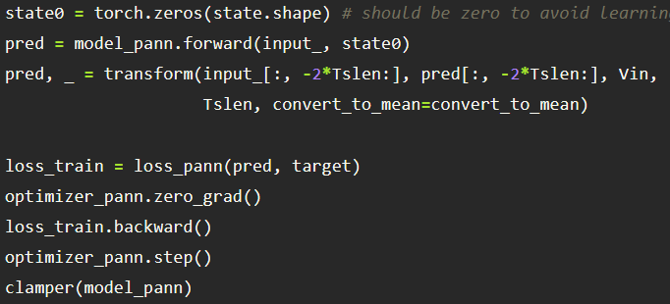
PANN Training Code Analysis
IV
Xinze Li, Fanfan Lin, Homer Alan Mantooth
Define an optimizer with different learning rates for neural θ
PANN Inference
Main Loop of PANN Training
pann_train.py :: def train
Evaluate Loss
Defined in
Backpropagate Loss
Define training process
Clamp Neural Parameters θ
Defined in
Define a clamper of class WeightClamp
Bound the weight during training to avoid unrealistic neural θ

Slide 42
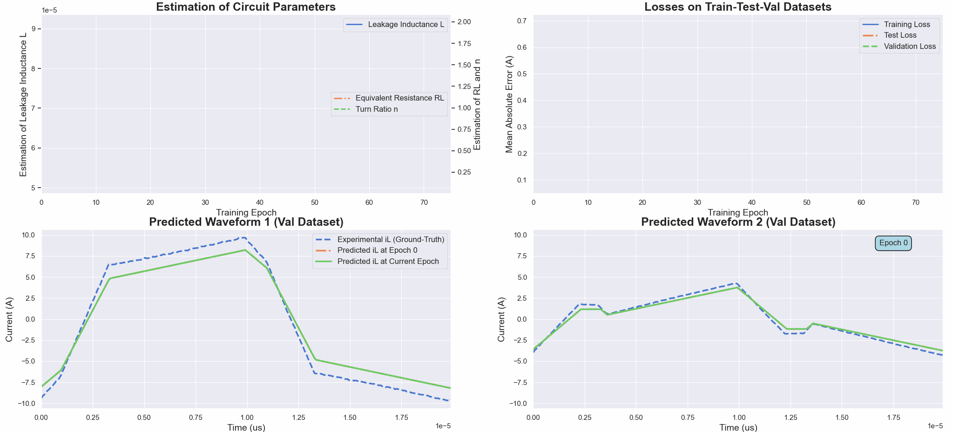
Case Study: PANN Training of DAB
IV
Xinze Li, Fanfan Lin, Homer Alan Mantooth
PANN Training (Code Demo*, "DAB-inference and training.ipynb")

Slide 43
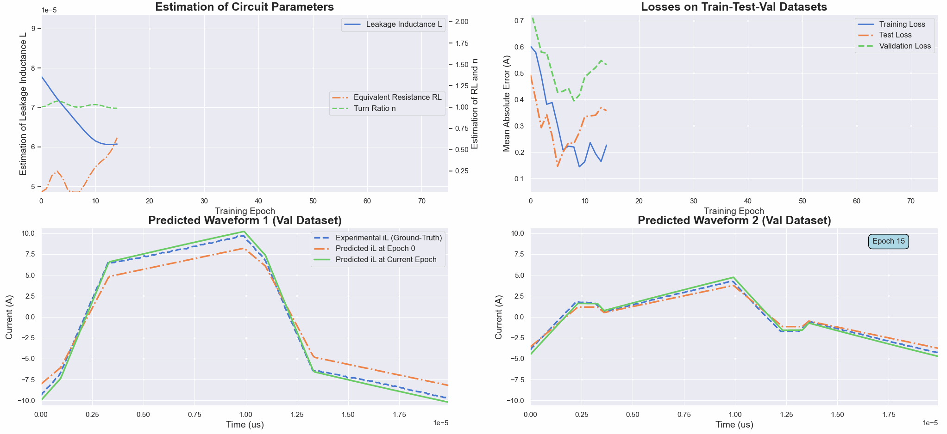
Case Study: PANN Training of DAB
IV
Xinze Li, Fanfan Lin, Homer Alan Mantooth
PANN Training (Code Demo*, "DAB-inference and training.ipynb")

Slide 44
Tuning of Learning Rates for PANN Training
IV
Xinze Li, Fanfan Lin, Homer Alan Mantooth
Tuning of learning rates
Training Performances w.r.t. Learning Rates
Training Curves

Slide 45
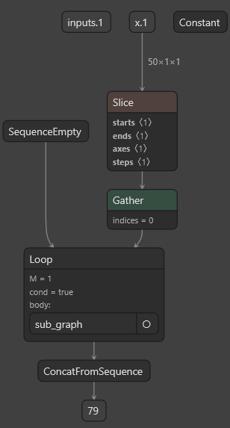
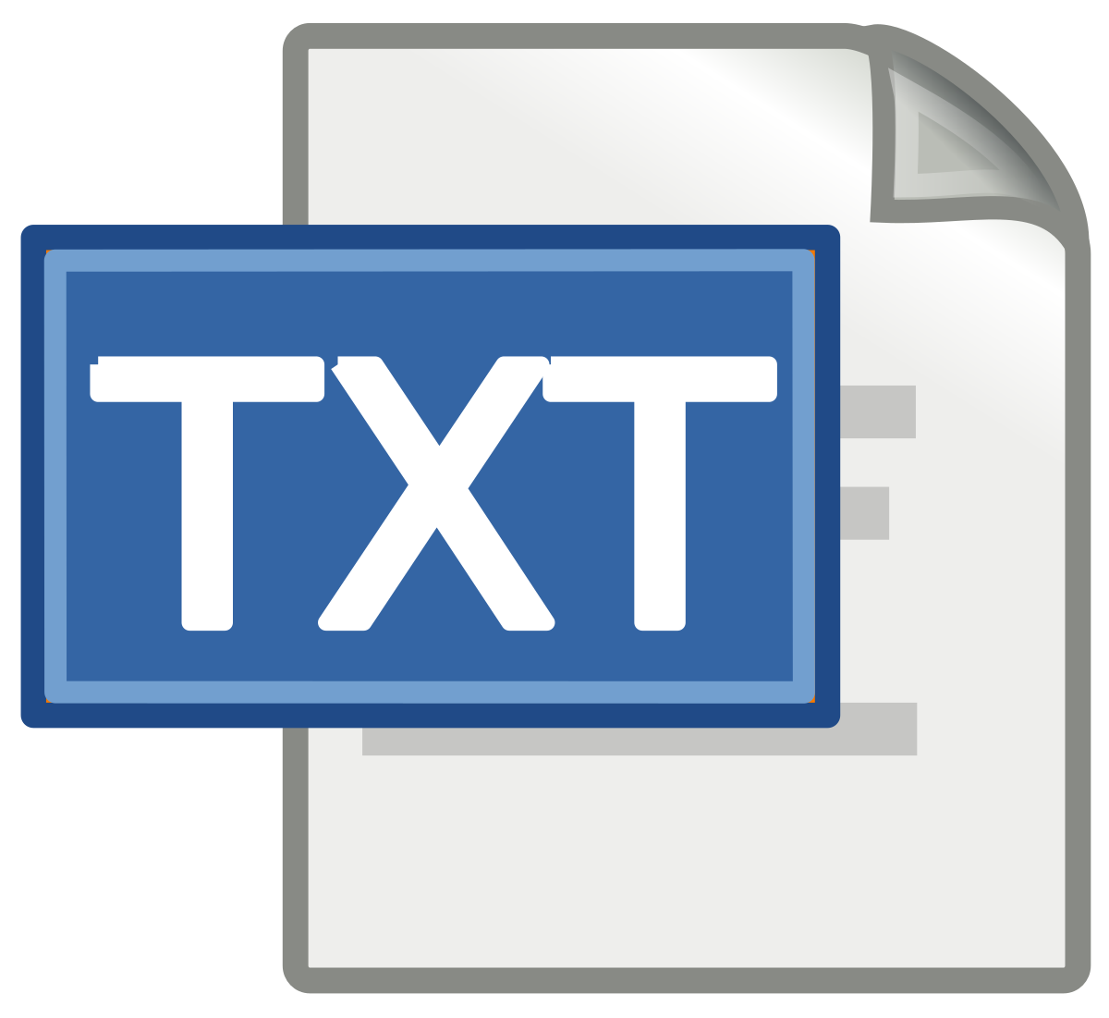
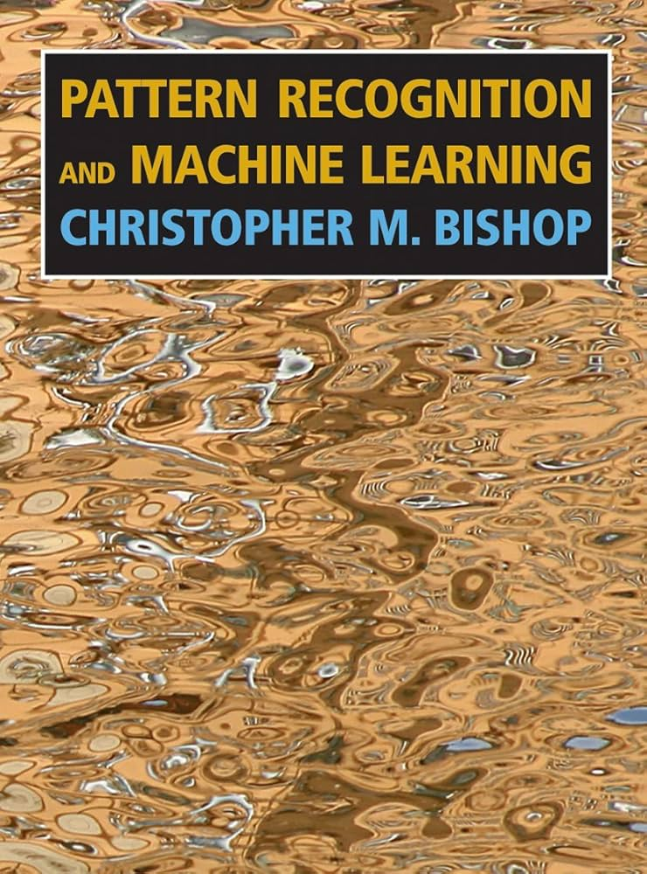
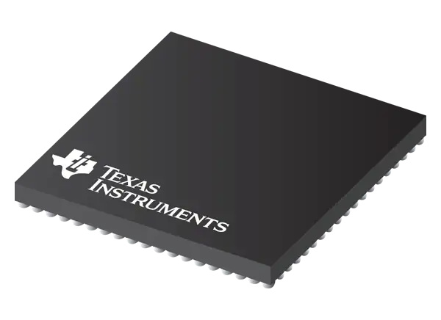
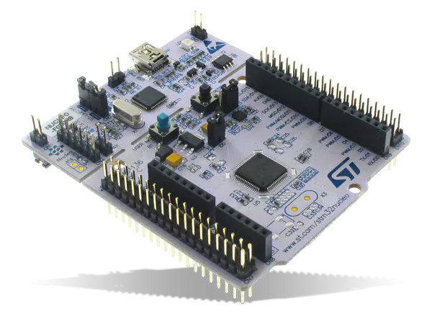
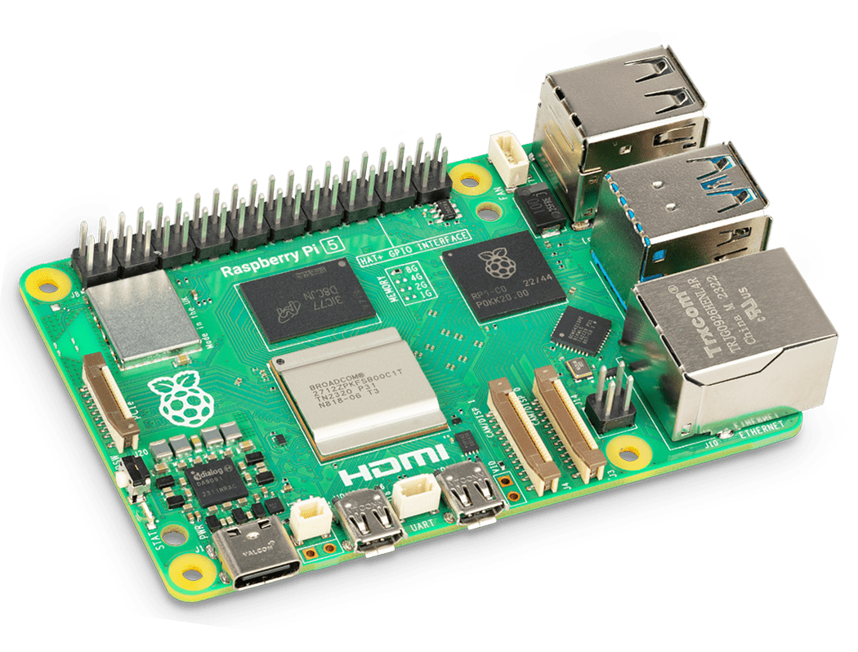
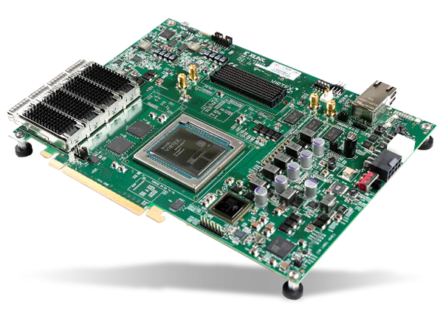
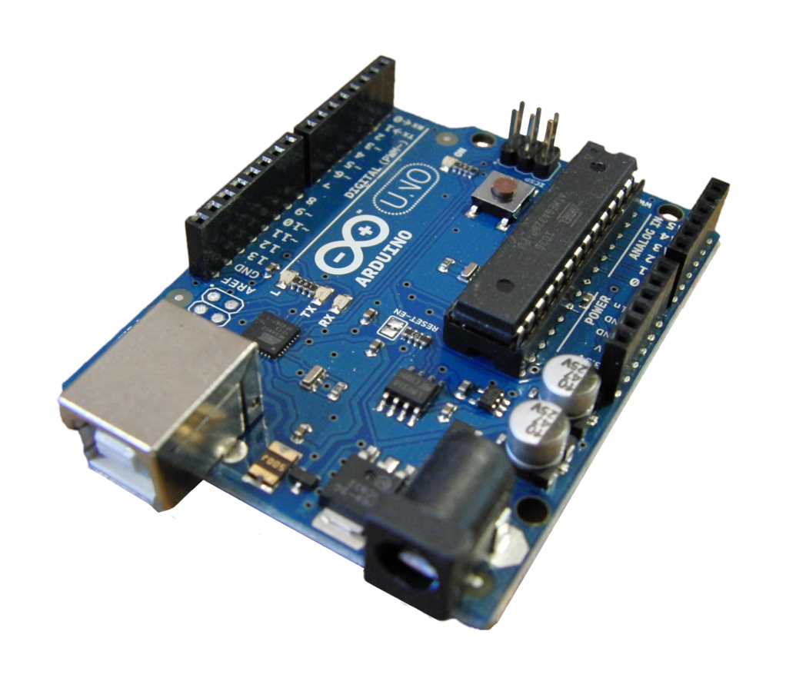
Next-Generation of Light AI for Power Electronics
IV
Xinze Li, Fanfan Lin, Homer Alan Mantooth
PANN is Data-Light.
PANN is Lightweight.
MAEs / A (mean±std.) | Data Sizes for (Train, Test, Validation) Sets
 | (10, 90, 900) | (50, 90, 860) | (100, 90, 810)
Piecewise | 0.311±0
SVR | 2.286±0 | 2.052±0 | 1.991±0
LSTM | 1.560±9.5E⁻² | 1.340±5.6E⁻² | 1.193±9.9E⁻²
TCN | 1.371±3.6E⁻¹ | 0.726±6.1E⁻² | 0.511±7.2E⁻²
PL-PINN | 0.310±1.3E⁻² | 0.259±1.1E⁻² | 0.234±7.3E⁻³
LN-GRU | 1.257±1.2E⁻¹ | 0.991±1.2E⁻¹ | 0.527±8.6E⁻²
PANN | 0.160±4.1E⁻³ | 0.145±3.6E⁻³ | 0.132±3.3E⁻³
1.72 kB of a PANN for DAB
1762 strings,
Approx. 160 words
Popular ML: Thousands, Millions, and MORE
Deployable on Edge
Data Size
PE Physics
Embed Data Invariant
≥
TMS320
STM32
PANN: a handful of data, reducing by 3 orders of magnitudes
#Params.
PANN Visualizer
Raspberry pi
Xilinx fpga
Arduino
PANN pioneers the next-generation of LIGHT AI for power electronics in:
1. Data: countable on ONE HAND, 2. Model size: deployable on EDGE DEVICE.

Slide 46



Key Takeaways of PANN Training
IV
Xinze Li, Fanfan Lin, Homer Alan Mantooth
Dataset division
1.
Training Flowchart of PANN
2.
Training Loop of PANN
Load training data
Training of PANN
PANN Inference
Hyperparameter tuning
Evaluate training loss
Update neural θ: backpropagate & clamp
Load model checkpoint
Takeaways
Validate PANN
Evaluate test loss
Learning rates lr of PANN should be carefully tuned
Low lr: slow convergence
High lr: large oscillation
Rule of thumb: lr to be 1% of parameter values
Data-light: training data required for PANN is countable on ONE HAND
Lightweight: few kBytes, deployable on resource-constrained EDGE devices
PANN Training
3. Hyper-Parameter Tuning of PANN
4.
PANN is a “Light“ AI Model

Slide 47
Section V. PANN is Flexible: “All You Need” is One PANN Model
Speaker: Xinze Li

Slide 48
PANN – Next Level of Flexibility: Training-Free
V
Xinze Li, Fanfan Lin, Homer Alan Mantooth
ONE PANN for Diverse Conditions and Topologies
Training-FREE
01
03
v_{i}
v_{o}
P_{L}, etc.
L_{k}
R_{L}
n, etc.
Operating Conditions
Performance Metrics
PANN’s Flexibility
02
04
PSM
PWM
Hybrid
Non-resonant
Resonant
Multi-port
Modulation Strategy
Circuit Parameter & Topology
Total Number of Conventional ML Models required:
MS×PM×OS×TP
Four Angles of PANN’s Flexibility

Slide 49
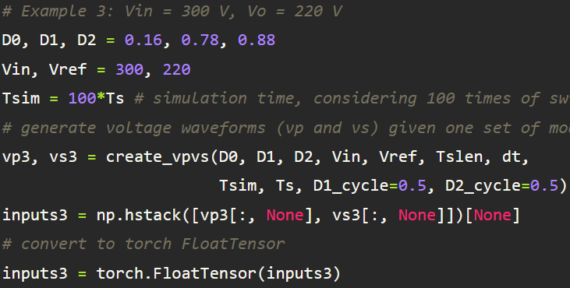
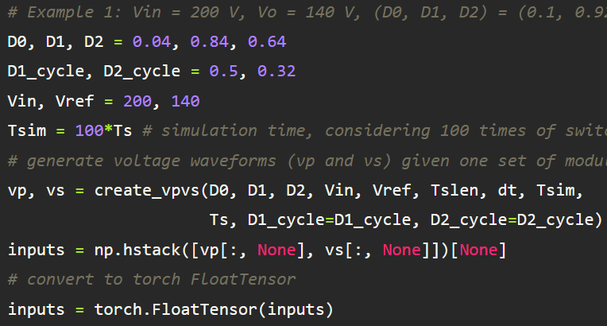
PANN – Flexibility across Conditions
V
Xinze Li, Fanfan Lin, Homer Alan Mantooth
Code Implementation
Adjust the Knowledge in Input Blocks
Flexibility across Conditions - DAB
Flexibility 1: Out-of-Domain Operating Conditions
Adjust v_{i} and v_{o}
Adjust expert system
Adjust Expert System
Flexibility 2: Diverse Modulation Strategies
Adjust duty cycles
Adjust expert system

Slide 50
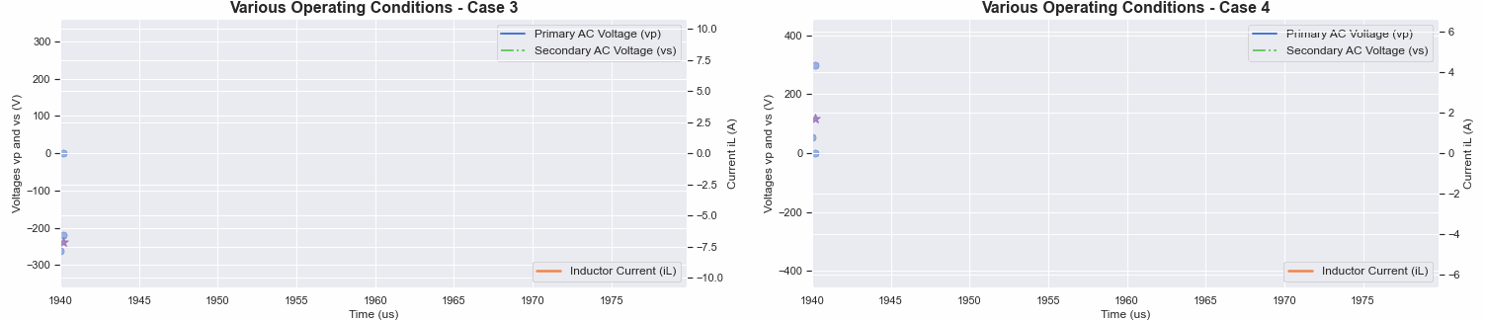
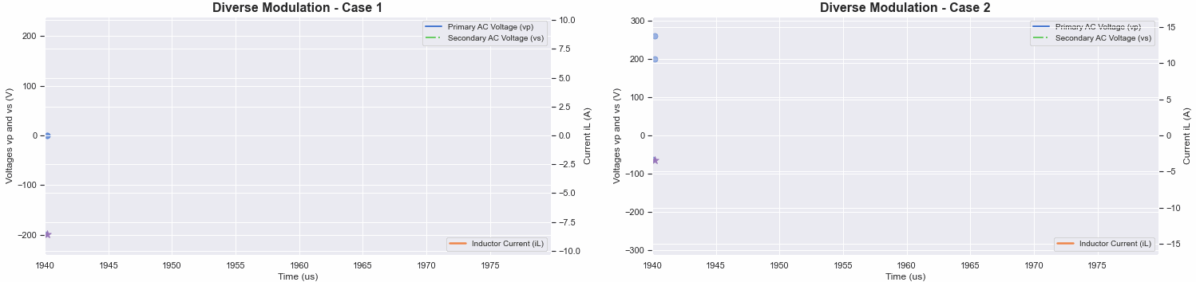
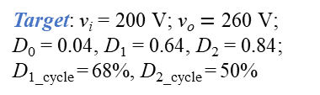




Case Study: PANN’s Flexibility across Conditions
V
Xinze Li, Fanfan Lin, Homer Alan Mantooth
PANN’s Flexibility across Conditions (Code Demo*, "DAB-Operational Transfer.ipynb")
Source: v_{i} = 200 V; v_{o} $∈$ [160 V, 240 V]
Target: v_{i} = 300 V; v_{o} $=\text{220} \text{V}$
Target: v_{i} = 300 V; v_{o} $=\text{380} \text{V}$
Source: TPS Modulation
Target: v_{i} = 200 V; v_{o} $=\text{140} \text{V}\text{; }\text{D}\text{0}\text{ = 0.05, }\text{D}\text{1}\text{ = 0.84, }\text{D}\text{2}\text{ = 0.64;}$
D_{1_cycle} = 50%, D_{2_cycle} = 35%
Target: v_{i} = 200 V; v_{o} $=\text{260} \text{V}\text{; }\text{D}\text{0}\text{ = 0.04, }\text{D}\text{1}\text{ = 0.64, }\text{D}\text{2}\text{ = 0.84;}$
D_{1_cycle} = 68%, D_{2_cycle} = 50%

Slide 51


PANN – Flexibility across Performance Metrics
V
Xinze Li, Fanfan Lin, Homer Alan Mantooth
Code Implementation
star_metric_adapter.py
Flexibility across Performance Metrics - DAB
Flexibility 3: Various Performance Metrics
Locate switching timestamp
Primary ZVS
Secondary ZVS
ZVS turning-on
Conduction loss
Transferred power
Circulating current, etc.
Q = v_{L,rms}·i_{L,rms}
i_{pp} = i_{L,max}-i_{L,min}
Peak-peak current
Reactive power
Current stress
One-Stop Metric Adapter for Diverse Performances
RMS current

Slide 52


PANN – Flexibility across Circuit Parameters
V
Xinze Li, Fanfan Lin, Homer Alan Mantooth
Code Implementation
Adjust Neural θ in Physics Cell Module
Flexibility across Circuit Parameters - DAB
Flexibility 4-1: Different Circuit Parameters
Directly assign new circuit parameters to neural θ
source: R_{L} = 120 mΩ; L_{k} = 63 μH; n = 1
target: R_{L} = 120 mΩ; L_{k} = 6.3 μH; n = 1
source
Training
Direct Assignment Training-Free
target
Flexibility across Different Circuit Parameters by Training or Direct θ Assignment
Circuit Parameter Transfer (Code Demo*)
"DAB-Operational Transfer.ipynb"

Slide 53
PANN – Flexibility across Topologies
V
Xinze Li, Fanfan Lin, Homer Alan Mantooth
Flexibility across Topologies - DAB Family
Flexibility 4-2: Different Topological Variants
Discretized by Implicit Euler:
Delete Branch
Add Branch
Discretized by Implicit Euler:
v_{C} is added into the voltage loop
Added physics of v_{C} of resonant capacitor
Topology Transfer between Non-Resonant and Resonant DAB

Slide 54


PANN – Flexibility across Topologies
V
Xinze Li, Fanfan Lin, Homer Alan Mantooth
Topology Transfer between Non-Resonant and Resonant DAB
Code Implementation
DAB-Topology Transfer.ipynb
Schematic Diagram of PANN for Topology Transfer
Non-resonant DAB with Single L
Add v_{C} into the voltage loop
Add physics of v_{C}
Added State
Add v_{c} into voltage loop
Add physics of v_{c}
Resonant DAB with Series LC
PANN’s Neural Link Transformation

Slide 55

Case Study: PANN’s Flexibility across Topologies
V
Xinze Li, Fanfan Lin, Homer Alan Mantooth
PANN’s Flexibility across Topologies (Code Demo*, "DAB-Topology Transfer.ipynb")
Source: Non-resonant DAB with Single L, L_{k} = 63 μH
Target: L_{r} = 63 μH, f_{r} = 1.1·f_{s} (Capacitive)
Target: L_{r} = 63 μH, f_{r} = 0.9·f_{s} (Inductive)
Target: L_{r} = 63 μH, f_{r} = 1.0·f_{s} (Resistive)

Slide 56


Statistical Study of PANN’s Flexibility
V
Xinze Li, Fanfan Lin, Homer Alan Mantooth
Flexibility across Conditions and Modulations
Statistics of Condition Transferability
Statistics of Modulation Transferability
R²=99.68%
R²=99.75%
Data Partition Settings to Validate Flexibility across Conditions

Slide 57
Statistical Study of PANN’s Flexibility
V
Xinze Li, Fanfan Lin, Homer Alan Mantooth
Flexibility across Performance Metrics and Modulations
Statistics of Performance Transferability
Statistics of Topology Transferability
R²=99.66%
R²=99.79%
Waveforms of Topology Transferability - LC
Waveforms of Topology Transferability - TAB

Slide 58



Key Takeaways of PANN’s Flexibility
IV
Xinze Li, Fanfan Lin, Homer Alan Mantooth
Flexibility I.
Operating Conditions
Flexibility II.
Modulation Strategy
Simply update operating params. in expert system to change input signals
Training-free
Switching behaviors in expert system should be updated accordingly
Training-free
Takeaways
Numerically gauge metrics based on input signals from expert system and state waveforms from PANN
Metric adapter is case-specific, rely on topology, modulation, etc.
Training-free
Circuit θ is adjustable if there is: 1) training data; 2) priori knowledge of θ (direct value assignment)
Topology transfer: add/del. neural links of PANN
PANN’s Flexibility
Flexibility IV.
Circuit Parameters & Topology
Flexibility III.
Performance Metrics

Slide 59

Section VI. Future Directions of PANN in Power Electronics
Speaker: Fanfan Lin

Slide 60

Future Directions of PANN in Power Electronics
VI
Fanfan Lin, Xinze Li
More nuanced, accurate, and comprehensive PANN
Design Automation
Health Monitoring
Model-based Design
Adaptive Control
PANN in PE
Design
Control
Maintenance
Co-design of topology, circuit, and control
Adaptive Diagnosis
Hybrid data-driven and physics-based modeling
Predictive Maintenance
More topologies
PANN in the Life Cycle of Power Electronics Systems

Slide 61



Future Directions of PANN in Power Electronics
VI
Fanfan Lin, Xinze Li
I. PE Design Automation
PE-GPT: Large language model-based framework for PE design
Modeling and optimization
Enhance Model Zoo
More nuanced and comprehensive PANN
PANN models for more converter topologies
Improve modeling accuracy
Optimal design insights
Source: F. Lin et al., "PE-GPT: A New Paradigm for Power Electronics Design," in IEEE Trans. on Ind. Electron.
Code: https://github.com/XinzeLee/PE-GPT
Training of PANN

Slide 62



Future Directions of PANN in Power Electronics
VI
Fanfan Lin, Xinze Li
II. Adaptive Control
III. Health Monitoring
Train
Continuously update PANN for online monitoring
Digital Twin
Represent
Update
Sampling
PANN
Predict
Collected Datasets
Converter behaviors
Predicted {y[t_{k}]}_{k}, {x[t_{k}]}_{k}
PANN with updated neural param. θ
COM
Minimize the cost function:
Edge Device
Online training

Slide 63
Conclusions
VI
Fanfan Lin, Xinze Li
AI algorithms applied in PE require explainable, light, and flexible solutions
PIML introduces physics expressed as PDEs into ML models to steer learning towards identifying physically consistent solutions
PIMLs can solve PDEs in forward ways and identify parameters in inverse settings
PIMLs are effective for ill-posed and mesh-free forward problems to solve PDEs and inverse problems to identify parameters.
Three types of PIMLs: Physics-in-loss, physics-in-architecture, physics-in-initialization
PIML
PANN
Physically crafted recurrent networks to integrate PDEs discretized by numerical methods
PANN features time-domain modeling for power electronics, where state variables are recurrently predicted leveraging the previous predictions of states
PANN is explainable in PE: Neural parameters of PANN are converter parameters, and switching behaviors, commutation loops, operating modes and so on are embodied
Explain-able
Conclusions
Training only requires few data samples, reducing data requirements by 3 orders of magnitude
PANN is lightweight (several kB), deployable on edge devices
PANN training equals to parameter identification, and learning rates are impactful hyperparameters
Light
Flexible across operating conditions, modulation strategies, performance metrics, circuit parameters, and topological variants
Training-free transfer (use knowledge to replace data)
Flexible
Future
Apply PANN in design automation, adaptive control, and health monitoring for power converters
More nuanced, accurate, and comprehensive PANN to incorporate more topologies

Slide 64


Thank you! Q&A
2024 Nobel Prize - Physics
Next-Generation of AI for Power Electronics
The ultimate frontier of AI is physics-informed AI.
Awarded to AI Pioneers
Organizer: Dehong Xu, Homer Alan Mantooth
Speaker: Xinze Li, xinzel@uark.edu
Fanfan Lin, fanfanlin@intl.zju.edu.cn
Huai Wang, hwa@energy.aau.dk
Xin Zhang, zhangxin_ieee@zju.edu.cn

